Slide 1
Fun with solar
Github: https://github.com/tobyvessalius/nasaopendataProject
Trello: https://trello.com/b/0PP00J8r/ec601-nasa-project
Xinran Zhang zhangxr@bu.edu
Jiahao Chen tobychen@bu.edu
Heming Huang hemingh@bu.edu
Siyue Wang siyuew@bu.edu
Notes:
1
Hi everyone we are the Fun with Solar group. I’m so excited to present to all of you our web application.
The design purpose of this application, the basic inspiration of the idea is that our teammates’ multiple backgrounds. We vary from power to the optoelectronic. And we figured out the combination of our backgrounds can make a great idea.

Slide 2



Web Application Aiming to:
*
https://www.solarcostguide.com/guides/wp-content/uploads/2015/06/Solar-Panel-Installer-1024x682.jpg
http://bramptondentalarts.com/wp-content/uploads/2013/08/FAMILY1.jpg
http://blog.hackerrank.com/wp-content/uploads/2015/10/government.jpg
2
Notes:
Our web application project generally speaking, is to analyze open data to decide if a place is suitable for building solar power plants and output this result to users. The potential user what we aiming to provide a service about the web application are PV industry contractors and government related departments. Unlike in China, the solar resources are used more comprehensively. People can set up their own eco-energy system and build their solar energy even on their roof. It is more flexible. Estimation the potential (投入产出比)of building a family-level solar power plant. What we can help is that make their decision easier to make.
When it comes to building a solar power plants, the government plays an important role. Usually they have their plan for the distribution of these power plants that make use of renewable energy sources. They should know where to build solar power plants and where to build wind power plants.

Slide 3
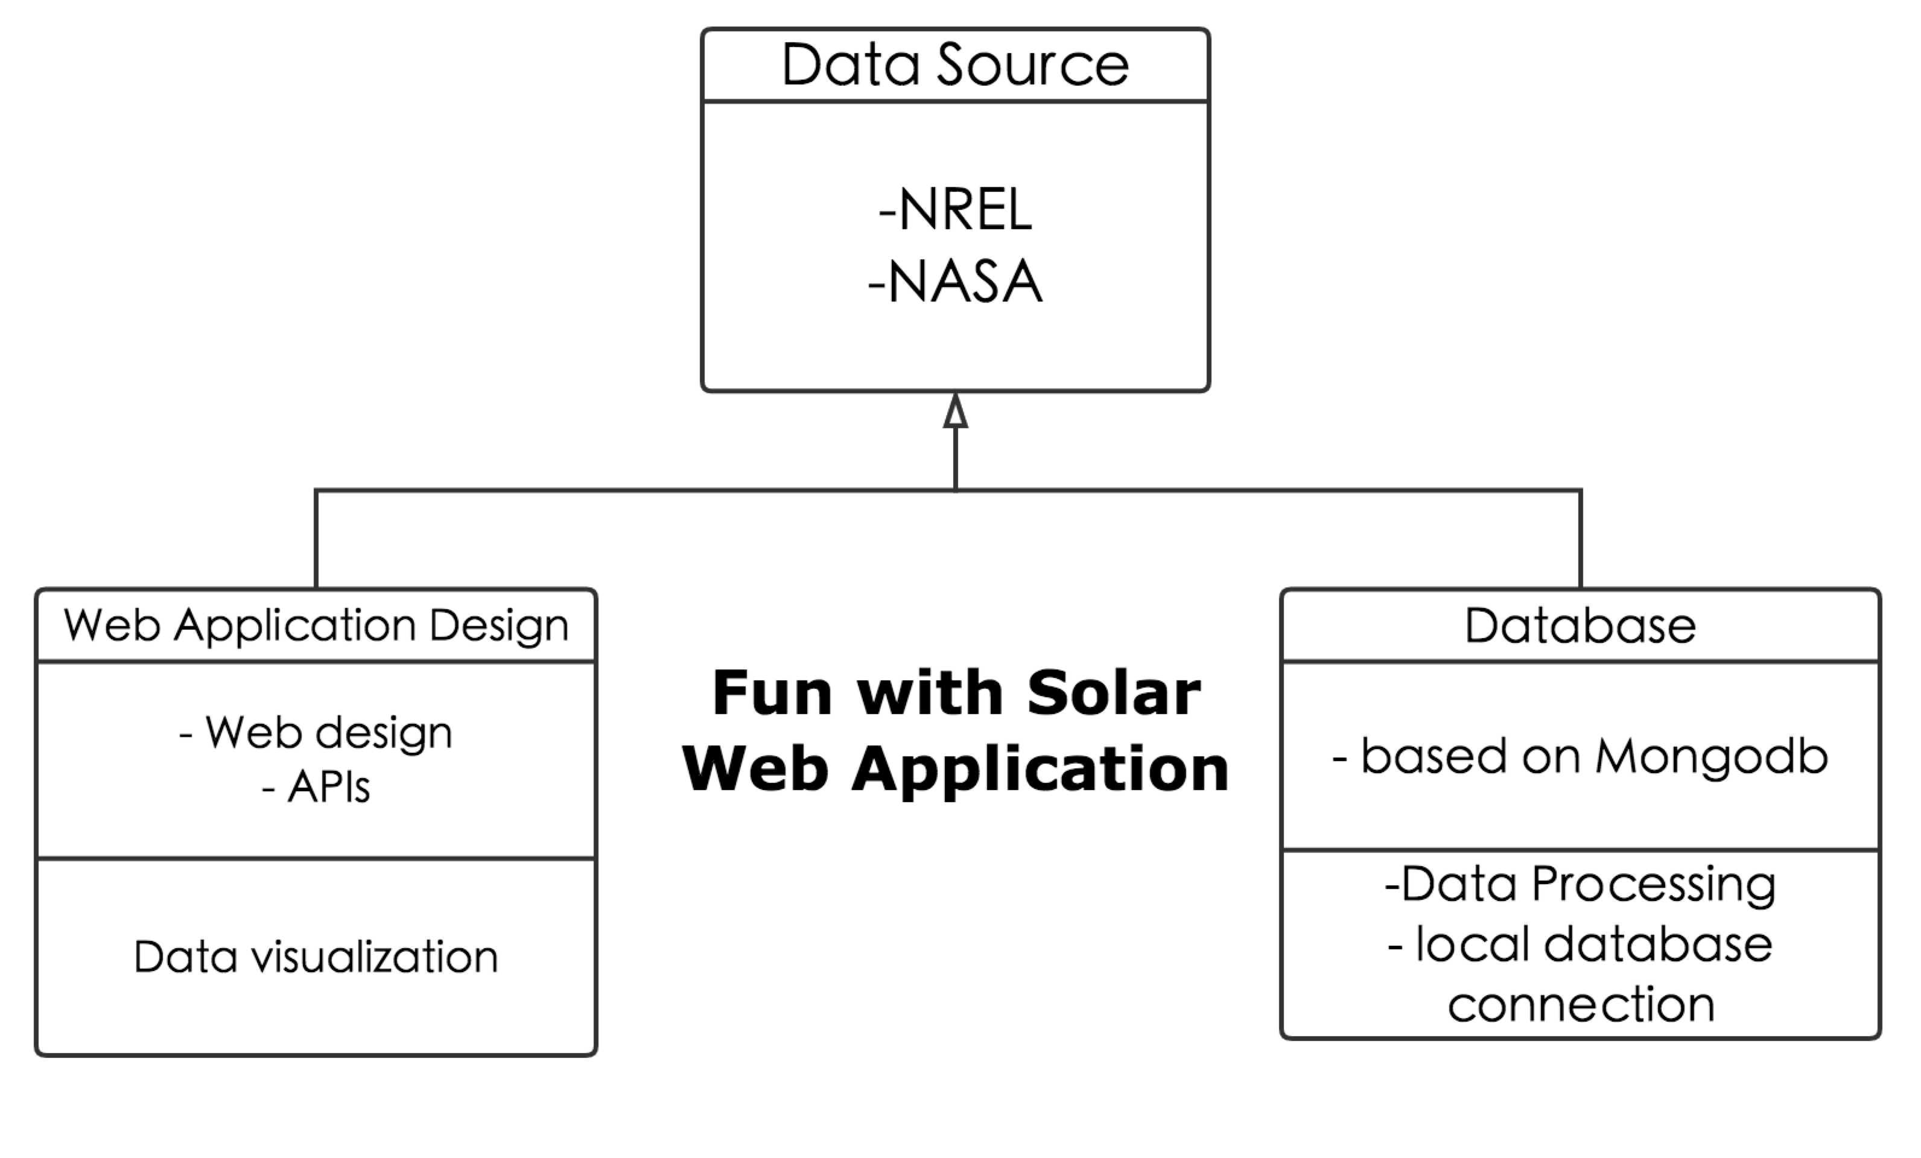
Project Structure
*
3
Notes:
As we can see that the structure of our application is mainly divided into three parts: the data that we collect to support our app is from National Renewable Energy Laboratory (NREL) and NASA.

Slide 4
Application System Diagram
*
NREL
Open Data
NASA
Data Analyses
Database
MongoDB
Evaluation System
Visualization
JavaScript
HTML
Web Application
CSS
4
Notes:
Cause the amount of the data is way too large, we set up the database with Mongodb to manage the data, set the filter to get the data we want and analyze large amount of data we have downloaded and present it in our web application, make it visualized. We designed the website via HTML and CSS. Also, in order to connect our data visualization tools and maps to our website, we managed the APIs.

Slide 5
Product Highlights
*
Original Data from NREL and NASA
Data Screening by scripts
Website and User Interface Design based on Bootstrap
Mongodb database managed data
Build up web user interface
Connect our local database with Visualization tools
Connect our website to AWS cloud service
Write two original scripts.
5

Slide 6
DEMO
*
https://d1cyl9m8kfhf2i.cloudfront.net/
6

Slide 7
Test
*
Via Monkey test
Browser compatibility
Scroll bar function
Mouse function
Click-on function
Media Play function
Jump function
Database Authentication…..
Defect Detected
•Media Play Function:
Users click on the A12:H32, and video should be played and when users click the 'x' on the up right side, it should be closed.
7

Slide 8
Project Summary
*
Things that worked well
Switch the direction and go back to the right track
Self-learning
Communication
8

Slide 9
Project Summary
*
Things that did not go well…
Data loss
Manage online database
Web Test
Essential Data lost by Siyue Wang so we had to go with the backup plan.
We used the database re-managing the data and sorted them in right form.
9

Slide 10
Perspective Optimization
*
Put the database online and update it more often on cloud using web service.
Build up models to create systematic plans for consumers.
Using multiple APIs to embedded the cost evaluation
Evaluation parts can be improved……
10

Slide 11
Reference links
*
NREL: http://www.nrel.gov/renewable_resources/
NASA: http://www.earthobservatory.nasa.gov/Features/SORCE/
Mongodb Tutorial: https://docs.mongodb.com/v3.2/tutorial/
APIs:
https://developers.google.com/maps/documentation/javascript https://developers.google.com/maps/documentation/streetview/ https://onlinehelp.tableau.com/current/api/js_api/en-us/JavaScriptAPI/js_api.htm
Tableau Tutorial:
http://www.tableau.com/learn/tutorials/on-demand/getting-started
11

Slide 12
THANK YOU
*
12

